Slide 1
Chapter 1: Exploring Categorical Data
Objectives
Students will be able to:
Graph categorical data
Model athletic PERFORMANCE
Use technology to simulate athletic PERFORMANCE

Slide 2
Graphing Calculator
https://www.youtube.com/watch?v=ilL9FoTUQqw
https://www.youtube.com/watch?v=rQLdYL_wMKM
https://www.youtube.com/watch?v=Zr1HIjL2DvQ

Slide 3
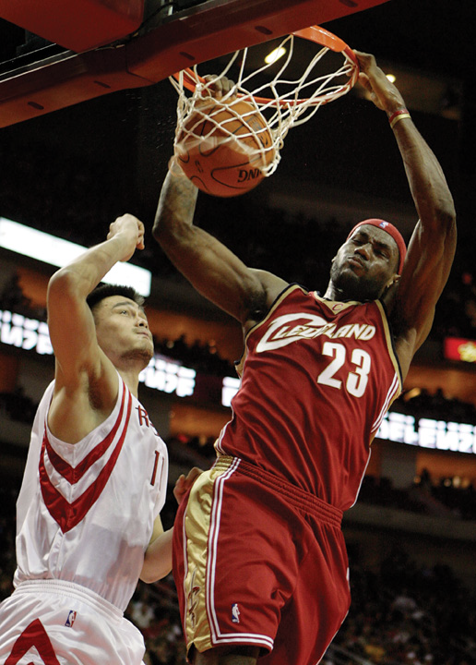
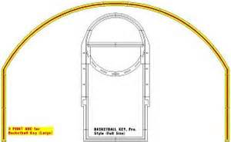
Question: Did LeBron James Choke in the Playoffs?
Let’s read pg 3
Three-point line

Slide 4
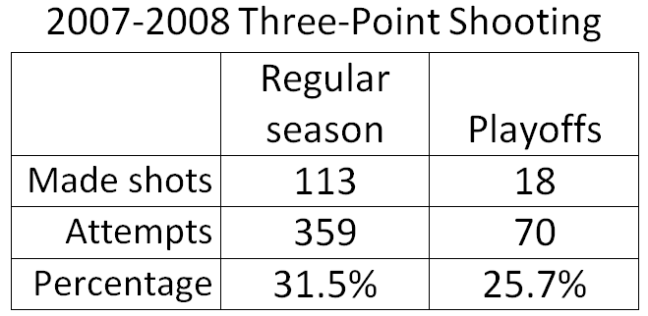
Background Information
2008 NBA Playoffs, the #1 seed Boston Celtics defeated the #4 seed Cleveland Cavaliers, 4 games to 3
How do we calculate shooting percentage?

Slide 5
Four-Step Statistical Process
1) Formulate questions
Examples:
Did LeBron James choke in the playoffs?
Is Paul’s curveball his best pitch?
Is Kara a clutch swimmer?
2) Collect data
LeBron’s shooting percentage, number of people that swing and miss at Paul’s curveball, number of races Kara wins
3) Analyze the data
4) Make conclusions

Slide 6
Terminology
Variable: characteristic or attribute of an athletic performance
Examples: number of passing yards for a quarterback; outcome of a playoff game
There are two different types of variables: categorical and numerical

Slide 7
Categorical variable: variable whose possible outcomes fall into categories
Examples:
outcome of a plate appearance in baseball (the outcomes are categories such as hit, walk, out)
a hockey teams winning percentage (the outcomes of each game are categories of win or loss)
the result of a shot in a basketball game (the outcomes are categories of make or miss)
In almost all cases, the outcomes of categorical variables are recorded with words
Occasionally, outcomes are recorded with numbers
Example: in softball, you might record 1 for a single, 2 for a double, etc…
Chapters 1-3 deal exclusively with categorical variables

Slide 8
Numerical variable: variable whose possible outcomes take on numerical values that represent different quantities of the variable
Examples:
distance a golf ball travels
time needed to swim 100 meters
Chapters 4-11 deal exclusively with numerical variables

Slide 9
Distribution: identifies the possible outcomes of a variable and how often it takes those outcomes
3 types of distributions for categorical variables are pie charts, segmented bar charts, and bar charts.

Slide 10
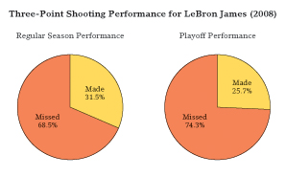
Pie chart: displays the possible outcomes of a categorical variable as slices of a circular pie, with the area of each slice proportional to how often each corresponding outcome occurred

Slide 11
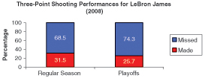
Segmented bar chart: displays the possible outcomes of a categorical variable as slices of a rectangle, with the area of each slice proportional to how often each corresponding outcome occurred

Slide 12
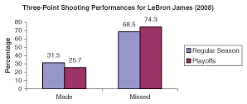
Bar chart: displays the possible outcomes of a categorical variable as individual equally wide bars, with the height of each bar proportional to how often each corresponding outcome occurred

Slide 13
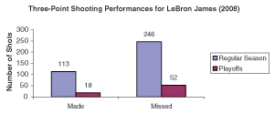
When comparing distributions, display the percentage in each category, NOT the number of observations.
Example with numbers, not percentages:
Is this giving us any type of useful comparison?

Slide 14
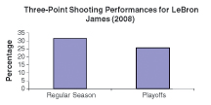
When there are only two possible outcomes for a categorical variable, you may make a bar chart that includes only bars for successes.

Slide 15
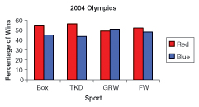
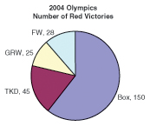
Does Uniform Color Make a Difference? Pg 7-8

Slide 16
Modeling Athletic Performance
PERFORMANCE = ABILITY + RANDOM CHANCE
The above model helps us analyze athletic performances.
PERFORMANCE: describes what an athlete did in a finite series of events
Examples: shooting percentage for a game, batting average for a season, number of heads flipped on a coin for 5 flips

Slide 17
ABILITY: describes what an athlete would do given an infinite number of opportunities in the same context
Example: A basketball player’s ABILITY to make a free-throw would be 60% if after millions and millions and millions of free-throws in the same conditions (nothing changes and the athlete doesn’t get tired) the player makes 60% of her free-throws.
Essentially, ABILITY is an unknown value (we cannot observe millions of attempts in the same context).

Slide 18
RANDOM CHANCE: describes the variation between an athlete’s PERFORMANCE and his or her ABILITY
Example: Gio might have an ABILITY of being a .310 hitter, but on a given day he hits .400. The difference between his ABILITY of .310 and his PERFORMANCE of .400 could be explained by RANDOM CHANCE. On another given day he might hit .000. This does not mean his ABILITY is .000, just his particular PERFORMANCE that day, which could be attributed to RANDOM CHANCE.

Slide 19
Terminology Comparison
It is important to note that a more “traditional” statistics textbook may use some different terminology. That is because those books extend beyond the world of sports and measure other characteristics of a population.
For example, you may see the term quantitative variable instead of numerical variable, or qualitative variable instead of categorical variable. They essentially mean the same thing.

Slide 20
In sports statistics, it is important to make the differentiation between ABILITY and PERFORMANCE. In traditional statistics, it is important to make the differentiation between a parameter (the true value of something) and a statistic (the estimate of a true variable).
Just like a statistic estimates a parameter, in sports, PERFORMANCE can estimate ABILITY, provided there are a large number of PERFORMANCES. Since we can never truly know ABILITY, we need a way to estimate it.

Slide 21
Let’s say Kyle’s ABILITY to make a free-throw is 50%. Let’s simulate his PERFORMANCE for 10 free-throws by flipping a coin.
Heads will represent a make, tails will represent a miss
A coin has the ABILITY to land on heads 50% of the time, just as Kyle has the ABILITY to make 50% of his free-throws
Will the ABILITY of the coin to land on heads 50% of the time mean that the PERFORMANCE of the coin will be exactly 50% in a short series of flips?

Slide 22
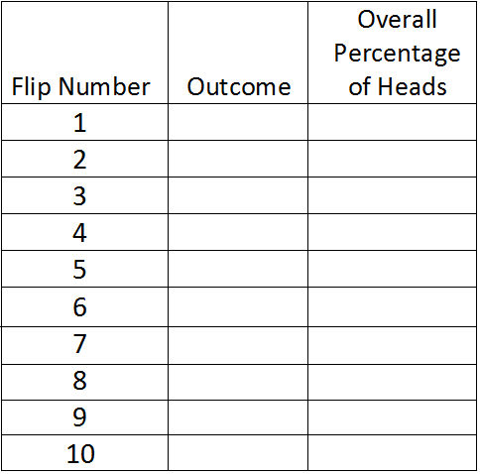

Slide 23
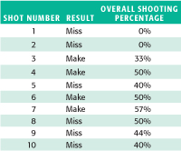
Let’s say Kyle actually took 10 free-throws, and these were the results:

Slide 24
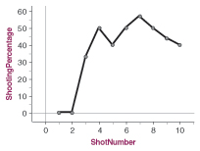
Here is another graph that displays the shot number and the shooting percentage after each shot attempt. Look at how much it fluctuates.

Slide 25
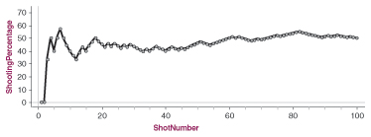
Now let’s look at what happened after Kyle took 100 free-throws.
How does this differ from the previous graph of only 10 shots? Why?

Slide 26
When Kyle took 10 free-throws, his shooting percentage varied greatly, being as low as 0% and as high as 57%. After Kyle took 100 free-throws, his shooting percentage fluctuated much less, and was closer to his actual ABILITY of 50%.
The law of large numbers states that an athlete’s PERFORMANCE will generally get closer and closer to his or her ABILITY as the number of attempts grows larger.

Slide 27
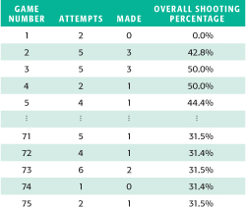
Three-point shooting PERFORMANCES of LeBron during the 2007-2008 regular season

Slide 28
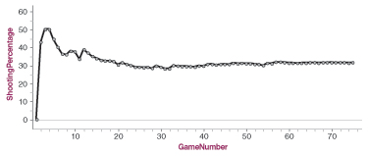
Another chart of the PERFORMANCES
As the three-point attempts increase, the graph gets closer to LeBron’s actual ABILITY to make a three-point shot.

Slide 29
Did LeBron actually choke?
What we know: LeBron’s three-point shooting PERFORMANCE was worse in the playoffs than in the regular season.
Possibilities:
His ABILITY to make three-pointers was the same in the playoffs as in the regular season, and thus his poor PERFORMANCE could be due to RANDOM CHANCE
Or, his ABILITY to make three-pointers was actually lower in the playoffs

Slide 30
Statistics works the same way as the American justice system: someone is “innocent until proven guilty.”
We must start with the assumption that LeBron is “innocent”, meaning that his ABILITY to make a three-point shot has not decreased (in other terms, his poor PERFORMANCE was due to RANDOM CHANCE).
We will only declare LeBron “guilty” if it is unlikely that his poor PERFORMANCE was due to RANDOM CHANCE.

Slide 31
Simulation
Let’s assume LeBron’s ABILITY to make a three-point shot is 31.5% (remember we never truly know ABILITY).
In the 2008 playoffs, he made 18 of 70 three-point attempts, or 25.7%.
We will simulate those 70 three-point attempts using a spinner. This will help us see if there is convincing evidence that LeBron’s ABILITY went down in the playoffs.

Slide 32
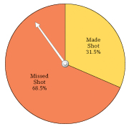
Go to www.shodor.org/interactivate/activities/AdjustableSpinner/
Change the number of sectors to 2, and make one percentage 31.5% (makes) and the other 68.5% (misses).
Spin 70 times.

Slide 33
Let’s display our results on a dotplot to show the shooting PERFORMANCES that occur by RANDOM CHANCE in 70 attempts. These dots represent what could have happened in the 2008 playoffs if LeBron’s ABILITY stayed the same as in the regular season.

Slide 34
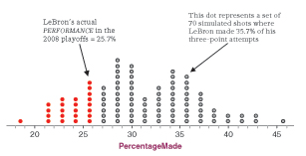
Here is a simulation of 100 PERFORMANCES.
Red dots indicate a PERFORMANCE of 25.7% or less. There are 23. Would you say it is unusual for a shooter with a 31.5% ABILITY to shoot 25.7%?

Slide 35
Since 23 out of 100 dots are red (23%), we can conclude that shooting 25.7% is NOT an unusual outcome for a shooter with an ABILITY of 31.5%.
Based on these results we would expect LeBron to shoot the same or worse in 23 out of every 100 playoff appearances simply by RANDOM CHANCE, even if his ABILITY remained constant at 31.5%.
New question: what is the boundary line between “likely to happen by RANDOM CHANCE and “unlikely to happen by RANDOM CHANCE?”
Generally, 5% is a reasonable boundary.

Slide 36
Conclusions
We must be very careful with our wording for conclusions.
Our conclusion: There is not convincing evidence that LeBron’s ABILITY to shoot three-pointers was lower in the playoffs.
This is NOT the same as saying “LeBron’s ABILITY to shoot three-pointers stayed the same.”
Consider a person on trial for murder:
If there is not convincing evidence that he is guilty, the jury must declare he is not guilty. However, this does not mean he is innocent.

Slide 37
If there is convincing evidence in a courtroom, the defendant would be found guilty. So when can we find someone guilty in statistics?
Say LeBron only made 15% of three-point attempts in the playoffs. In our simulation, this only happened 1 time out of 100. Based on the simulation, we would have convincing evidence to support the claim that his ABILITY did decrease in the playoffs.

Slide 38
Other important concepts
We usually cannot determine the cause of an increase or decrease in ABILITY, even if we have convincing evidence of the change in ABILITY. We can only test to see if ABILITY changed or remained the same, not why it changed.
Even if we have convincing evidence that an athlete’s ABILITY has changed, we don’t have conclusive evidence. It is always possible that the unusual PERFORMANCE could be due to RANDOM CHANCE, even if it is very unlikely.

Slide 39
Always remember the law of large numbers.
The larger the number of attempts, the more likely it is that we can rule out RANDOM CHANCE as an explanation for poor PERFORMANCE.
Let’s run two different simulations:
1) 100 simulations for LeBron taking 7 three-point shots in the playoffs
2) 100 simulations for LeBron taking 700 three-point shots in the playoffs
Which simulation will we be more likely to rule out RANDOM CHANCE for a poor PERFORMANCE?

Slide 40
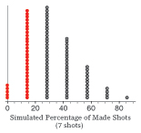
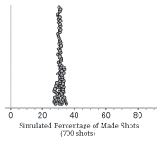
The graph on the left, a PERFORMANCE of 25.7% or lower happens fairly often by RANDOM CHANCE

Slide 41
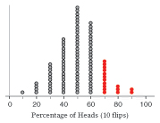
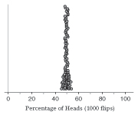
Think back to coin flipping. Would it be more surprising to get 7 or more heads in 10 flips, or 700 or more heads in 1000 flips?

Slide 42
In a large number of attempts, an athlete’s PERFORMANCE should be fairly close to his or her ABILITY so that extremely poor or extremely good PERFORMANCES would be very surprising.
Let’s look at pgs 16-17

Slide 43
Using Technology to Simulate Athletic PERFORMANCE
What does it mean for an athlete to be clutch?
In sports, the term clutch refers to an athlete that seems to have a better ABILITY to play in high-pressure situations, such as the playoffs or end-game situations.
Do such players actually exist???

Slide 44
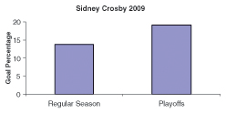
In the 2008-2009 NHL regular season, Sidney Crosby made 33 of 238 shots on goal (13.9%). During the playoffs that season, he made 15 of 79 shots (19.0%).
His PERFORMANCE, as measured by goal percentage, was definitely better in the playoffs.

Slide 45
Remember, there are two possible explanations for Crosby’s improved PERFORMANCE.
1) he had a greater ABILITY in the playoffs
2) his ABILITY stayed the same and his exceptional PERFORMANCE was simply due to RANDOM CHANCE.
Let’s run a simulation to see what kinds of PERFORMANCES are likely to happen by RANDOM CHANCE.

Slide 46
One way to run the simulation would be using the spinner.
A spinner is great for getting one simulation of 79 attempts.
Note: To get a good picture, we would want to run more than one simulation (e.g. around 100 simulations, as we did in our LeBron simulation).
Another way would be using the applet from the textbook website at www.whfreeman.com/sris (this does not work on iPads).
Go to the website, click on applets, then click on Proportion of Successes applet.
Enter the ABILITY of 0.139 and enter 79 attempts, then press “simulate.”
To simulate multiple PERFORMANCES, utilize the box for “Get results.” Try simulating 100 results.

Slide 47
From this simulation, is it unusual to score 15 or more goals? (equivalent of 19% or higher goal scoring rate)
Our conclusion:
We do not have convincing evidence that Crosby had a greater ABILITY in the playoffs than in the regular season.
We make this conclusion because based on our data, scoring 15 or more goals is something that can happen just by RANDOM CHANCE. As a result, RANDOM CHANCE is a plausible explanation for Crosby’s clutch performance.

Slide 48
Random Number Generator
A random number generator is another way to run a simulation
It works like picking numbers out of a hat.
For example, say you have 10 ping pong balls in a hat. To select a number, you mix up the ping pong balls, draw one number at random, write it down, and then replace it. This process then gets repeated until you have reached the amount of attempts. In the Crosby case, you would want to get 79 numbers.

Slide 49
Random Number Generator
Each number has an equal chance of being selected.
The likelihood of a certain number being selected does not depend on what numbers were drawn previously. This means that each number is independent of the others (knowing the previous numbers does not help predict the following number).

Slide 50
Random Number Generator
Random number generation can be done on the TI calculators (steps on pages 20-21). There are also websites with random number generators, as well as apps on the iPads for random number generators. Some are better than others.
This website has the Carucci seal of approval: www.randomizer.org/form.htm

Slide 51
When we run this simulation, we will use the numbers 1-1000.
Selecting a number 1-139 will represent a goal (this is 13.9%)
Selecting a number 140-1000 will represent a missed or blocked shot.
We will then randomly select 79 numbers.
Where it says “how many sets of numbers do you want”, if you only want to run one simulation, leave it at 1. If you want to run 100, as we did with the applet, then change it to 100.
Sets of numbers: 79
from 1 to 1000
Select “no” for numbers remaining unique
Sort from least to greatest

Slide 52
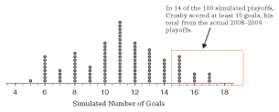
Looking at the simulations, do you still agree with our previous conclusion that we do not have convincing evidence that Crosby had a greater ABILITY in the playoffs than in the regular season?
Let’s read about Nick Rimando, pgs 23-24

Slide 53
Caution: Misleading Graphs
This is a horizontal “bar graph” to represent the favorite sport of 7 people. Three people chose football, and four chose baseball. Is this graph okay, or is it misleading? Why?

Slide 54
When making any graph, avoid adding embellishments that are potentially misleading.
The graph on the previous page violated the area principle, meaning that the area representing each category in a graph should be proportional to the number of observations in that category.
The area of each baseball was much larger than the area of each football. This can be avoided by making the pictures the same size, or by not using pictures at all (use bars!).

Slide 55
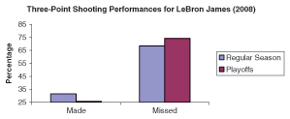
How does this bar chart look?
The percentage axis does not start at 0. It looks as if LeBron missed almost all of his three-point shots.

Slide 56
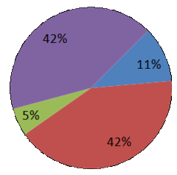
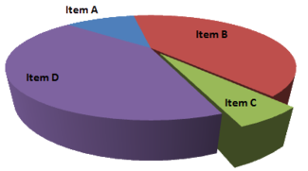
Does anything look wrong with this graph? (I left the percentages off for a reason).
The 3D design makes the slices closer to the reader appear larger than those in the back. The red and purple slices are both 42%, but the purple looks much larger.

Slide 57
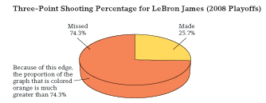
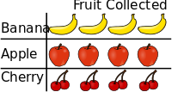
More examples…

Slide 58
Looking forward…
We will continue to see our model for athletic performance:
PERFORMANCE = ABILITY + RANDOM CHANCE
We will do more than compare a single PERFORMANCE to ABILITY.
An example will be comparing two PERFORMANCES with each other, such as Winning Percentage at Home vs. Winning Percentage on the Road.

Slide 59
Investigation
Stats Investigation Project
using powerpoint or google presentations
1st You will choose a player and investigate if he or she has a lower(or higher) ability in particular circumstances.
2st Start by introducing the player and the context in which he or she plays. Include short BIO and a couple of Pictures.
3rd Create and use a graph to compare his or her performances (use excel or google sheets).
4th Use the applet from Chapter 1 to simulate the athlete’s performance in the later time period, assuming that there has been no change in ablility in at least 50 trials.
5thUse the information gathered to discuss if there is convincing evidence that the athlete’s ability has changed. If there is convincing evidence of a change, discuss possible explanations

